Slide 1

NAME: RAJESH R
REG NO: 31024U09039
NMID: 6EC826C0E507DEF9CBE4B699EBA87FB4
DEPARTMENT: BCA
COLLEGE: GOVERNMENT THIRUMAGAL MILLS COLLEGE
UNIVERSITY: THIRUVALLUVAR UNIVERSITY

Slide 2

PROJECT TITLE :
DATA SCIENCE & ANALYTICS
Interactive digital portfolio using frond-end development
This presentation outlines a comprehensive data science and analytics project, designed to transform raw data into actionable business intelligence. We explore the challenges of data management, the solutions provided by modern analytics, and the significant impact on decision-making across various organizational levels.

Slide 3
AGENDA
1. Problem Statement
2. Project Overview
3. End Users
4. Tools and Technologies
5. Portfolio design and Layout
6. Features and Functionality
7. Results and Screenshots
8. Conclusion

Slide 4




The Problem Statement
Data Overload
Lack of Insight-Driven Decisions
Organizations grapple with immense volumes of data, often making it challenging to extract meaningful insights. This deluge can obscure critical information, hindering effective decision-making.
Many crucial business decisions are still based on intuition rather than empirical evidence, leading to missed opportunities and suboptimal outcomes in a competitive landscape.
Unstructured & Inconsistent Data
Inefficient Manual Reporting
Data often exists in messy, incomplete, and varied formats, making it difficult to integrate, process, and analyze effectively. This inconsistency can lead to erroneous conclusions.
Traditional manual reporting processes are time-consuming, prone to human error, and struggle to keep pace with the dynamic nature of modern business operations.

Slide 5

PROJECT OVERVIEW
Key Objectives
This initiative focuses on establishing a robust end-to-end analytics pipeline. It encompasses every stage from data collection and rigorous cleaning to in-depth analysis, compelling visualization, and clear interpretation of findings. The goal is to create a seamless flow that transforms raw data into actionable business intelligence.
01
Develop a Comprehensive Analytics Pipeline
Leveraging powerful tools like Python, Pandas, and Power BI, we aim to construct an automated and scalable data processing framework.
02
Analyze Trends & Predict Outcomes
Utilize advanced machine learning techniques to uncover hidden patterns, forecast future trends, and predict key business metrics with high accuracy.
03
Present Actionable Results
Translate complex analytical findings into intuitive and interactive dashboards, enabling stakeholders to make informed, data-driven decisions quickly.

Slide 6


Our End Users
Our data science and analytics project is meticulously designed to serve a diverse group of stakeholders, each gaining unique and significant advantages from the insights generated. By catering to their specific needs, the project ensures widespread adoption and maximized impact.
Business Analysts
Data Scientists
Empowered with real-time dashboards to track Key Performance Indicators (KPIs), identify emerging trends, and drill down into specific business segments for deeper understanding.
Can leverage and reuse the robust analytics pipeline for future projects, accelerating development cycles and ensuring consistency in data processing and model deployment.
Managers & Executives
Clients & Stakeholders
Receive high-level visual insights that simplify complex data, enabling rapid and confident decision-making based on a clear understanding of organizational performance.
Benefit from clear, transparent, and quantifiable performance metrics, fostering trust and demonstrating the tangible value and impact of implemented strategies.

Slide 7


Tools and Technologies
The success of this data science and analytics initiative hinges on the strategic selection and integration of industry-leading tools and technologies. Our stack is designed for efficiency, scalability, and robust performance across all phases of the project.
Core Frameworks
Programming
Python: Versatile for scripting, data manipulation, and machine learning.
SQL: Essential for database querying and management.
Data Analysis
Pandas: High-performance data manipulation and analysis.
NumPy: Fundamental package for numerical computing in Python.
Machine Learning
Scikit-learn: Comprehensive library for traditional ML algorithms.
XGBoost: Optimized distributed gradient boosting library for speed and performance.
Supporting Ecosystem
Visualization
Matplotlib, Seaborn, Plotly: Static and interactive plotting for data exploration.
Power BI: Business intelligence tool for dynamic dashboards and reporting.
Data Cleaning & Prep
OpenRefine: Powerful tool for messy data transformation.
Pandas: In-depth data wrangling and preprocessing capabilities.
Deployment & Version Control
Streamlit, GitHub Pages: Rapid prototyping and web app deployment.
Git, GitHub: Collaborative version control for code and project assets.

Slide 8
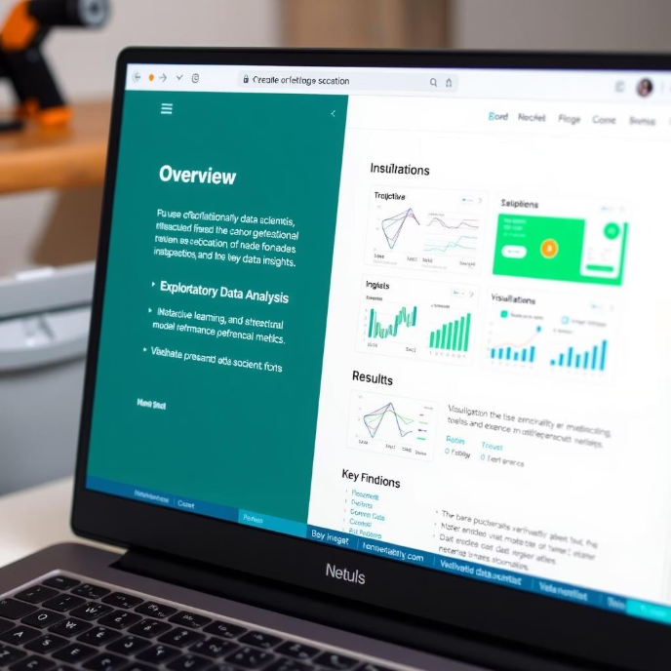
Portfolio Design and Layout
A well-structured and intuitively designed portfolio is crucial for effective communication and user engagement. Our design principles prioritize clarity, accessibility, and visual appeal, ensuring that insights are easily digestible and impactful.
Project Structure: Organized for Clarity
/data
Contains all raw and processed datasets, ensuring data provenance and reproducibility.
/notebooks
Jupyter notebooks for exploratory data analysis, model development, and testing.
/visuals
Static and interactive visualization outputs, ready for presentation and integration.
/models
Trained machine learning models, saved for deployment and future use.
/docs
Project documentation, setup guides, and analytical reports for comprehensive understanding.
Layout & User Interface: Intuitive and Engaging
Minimalist Dashboards
Clean and uncluttered interfaces focus on key insights, avoiding visual noise.
Color-Coded Graphs
Strategic use of color for easy interpretation of data trends and categories.
Responsive Layouts
Optimized for seamless viewing across various devices and screen sizes.
User-Friendly Interface
Incorporates tooltips and interactive elements for enhanced data exploration.

Slide 9
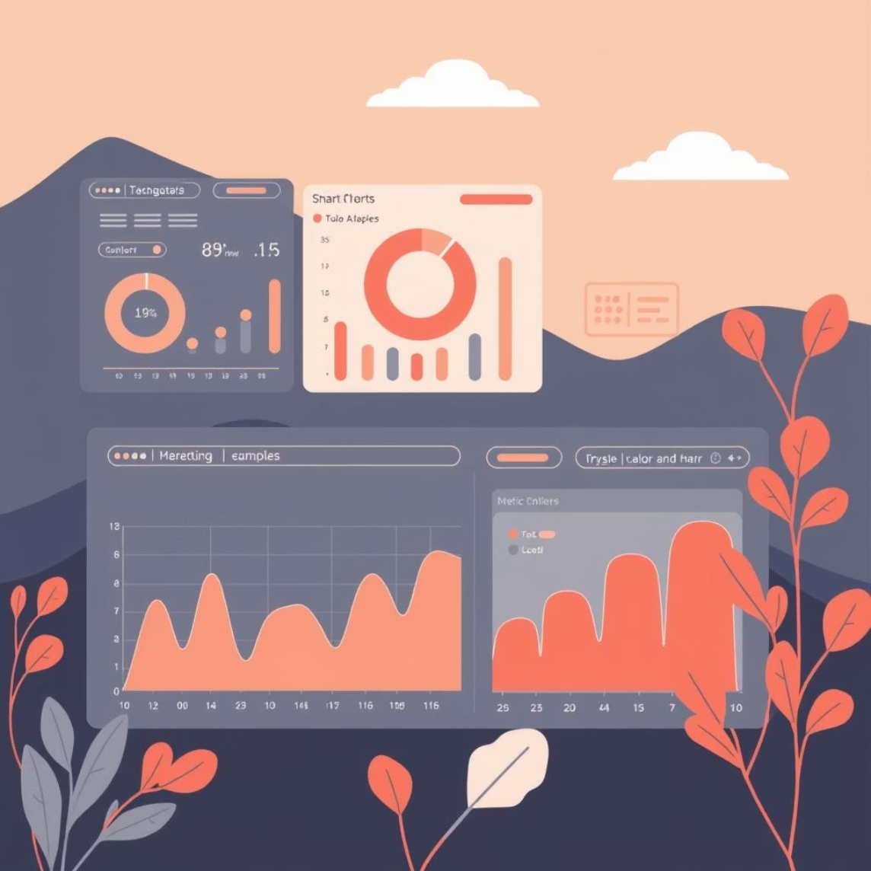
Features and Functionality
This project is built with a rich set of features designed to provide comprehensive data analysis capabilities, from raw data processing to advanced predictive modeling and intuitive visualization.
1
Data Ingestion & Cleaning
Automated processes for loading data from various sources (CSV, Excel, databases) and robust routines for handling missing values, outliers, and inconsistencies to ensure data quality.
2
Exploratory Data Analysis (EDA) Dashboard
Interactive dashboards presenting key statistical summaries, data distributions, and heatmaps to quickly understand the underlying patterns and characteristics of the data.
3
Correlation Analysis
Utilizes Pearson correlation and visual heatmaps to identify relationships between variables, helping to uncover dependencies and potential drivers within the dataset.
4
Predictive Modeling
Implementation of various machine learning algorithms for both classification (e.g., predicting categories) and regression (e.g., forecasting numerical values).
5
Model Evaluation
Comprehensive assessment of model performance using key metrics such as accuracy, recall, precision, and F1-score to ensure reliability and effectiveness.
Interactive Data Visualization
Dynamic graphs and charts that allow users to filter, zoom, and explore data points, making complex information accessible and engaging.
Report Generation
Functionality to download analytical reports and dashboards in professional formats like PDF, facilitating easy sharing and offline review.
Optional: API Integration
Future-proofing the solution with the ability to integrate with external APIs for real-time data feeds and enhanced functionality.

Slide 10
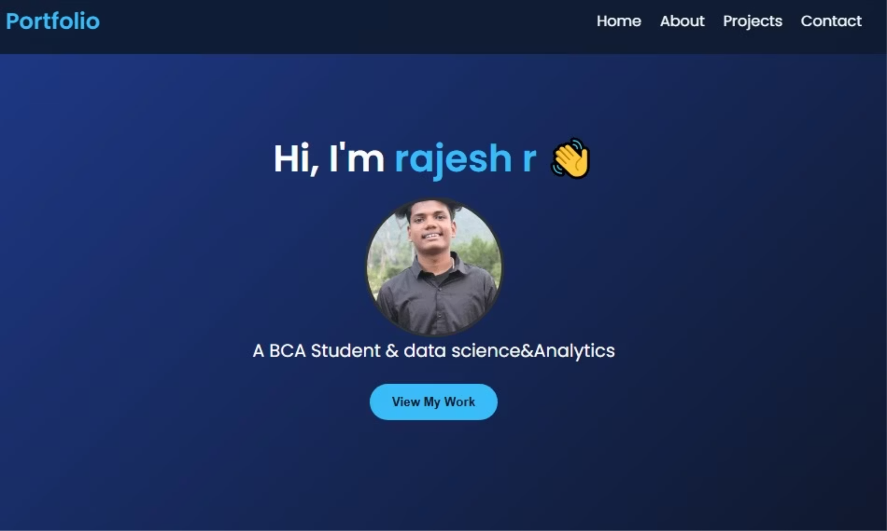
Results and Screenshots
Our project demonstrates significant improvements in data processing efficiency and the quality of derived insights. Here's a glimpse into the impact and performance achieved using a representative dataset

Slide 11

Conclusion and Next Steps
This project successfully demonstrates the transformative power of data science, turning raw, often overwhelming data into clear, actionable business intelligence. It provides a robust foundation for future analytical endeavors.
Data-Driven Transformation
Empowering Confident Decisions
Modular & Scalable
Successfully showcased how structured data science methodologies can transform raw data into invaluable business intelligence, driving informed decisions.
The project's output enables stakeholders to make confident, data-backed decisions, moving away from intuition-based approaches to a more strategic, empirical framework.
The pipeline's modular design ensures high scalability and adaptability, making it applicable across diverse industries such as finance, healthcare, and marketing.
Future Enhancements
1
2
3
Automate Deployment
Real-Time Data Streams
Advanced Anomaly Detection
Implement continuous integration/continuous deployment (CI/CD) practices for seamless model updates and dashboard refreshes.
Integrate capabilities for processing and analyzing data in real-time, providing instant insights for dynamic business environments.
Develop and deploy algorithms for identifying unusual patterns or outliers in data, crucial for fraud detection or system monitoring.

